Slide 1
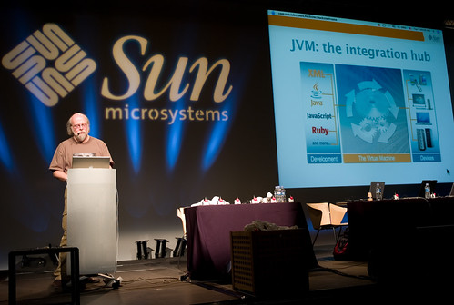
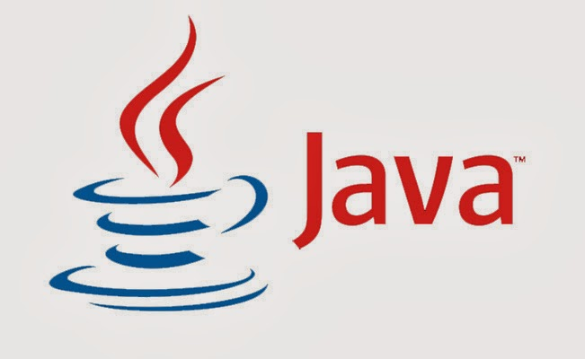
James Gosling
Sun Microsystems
Green Team
Oak programming language renamed java
Name by island of Java.
Breef History of Java
1991s
James Gosling, Mike Sheridan, and Patrick Naughton
1996s
How to Java Code work
Java source code
a
Java Byte Code
JVM
Java Compiler
Machine code

